Slide 1

Analysis of the Top 207 self-help books on Amazon

Slide 2

Original Question
Is there a correlation between price and rating of a book?
Are books that have more reviews rated higher than the rest.

Slide 3
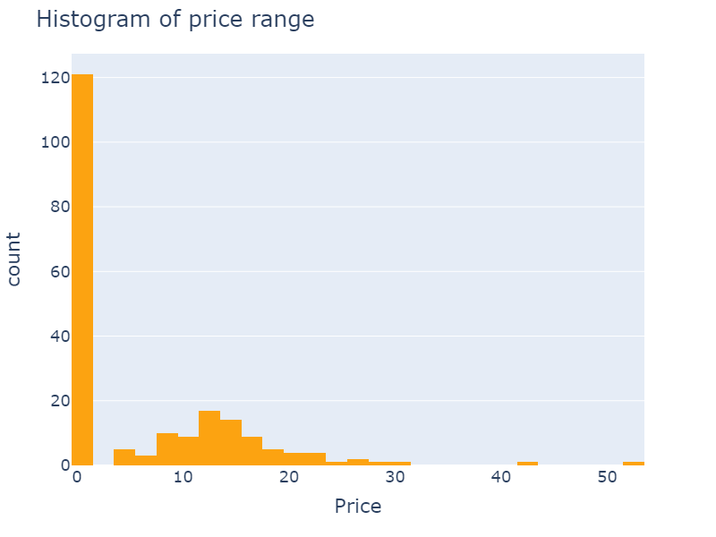
The Audible Approach
Amazon’s Audible has a U.S. market share in the audiobook publishing category of 63.4% as of 2022.
U.S. Audiobook publishing generated $1.6 billion as of 2021.
Around $1.01 billion of this figure was generated by Audible sales, based on market share.

